Slide 1
FATIMA Daily Weather Briefing
July 4
WRF forecast
Zheqi Chen

Slide 2
Model setting
Daily forecast focusing on the period between daily meeting at 1700UTC, with a 12-hour spin-up time.
Starting at 06Z. 06Z – 18Z is the spin-up time, and 18Z today to 18Z tomorrow is the result.
Domain is 10km resolution. The grid point of SI is water surface.
51 vertical levels, lowest level 4m.

Slide 3
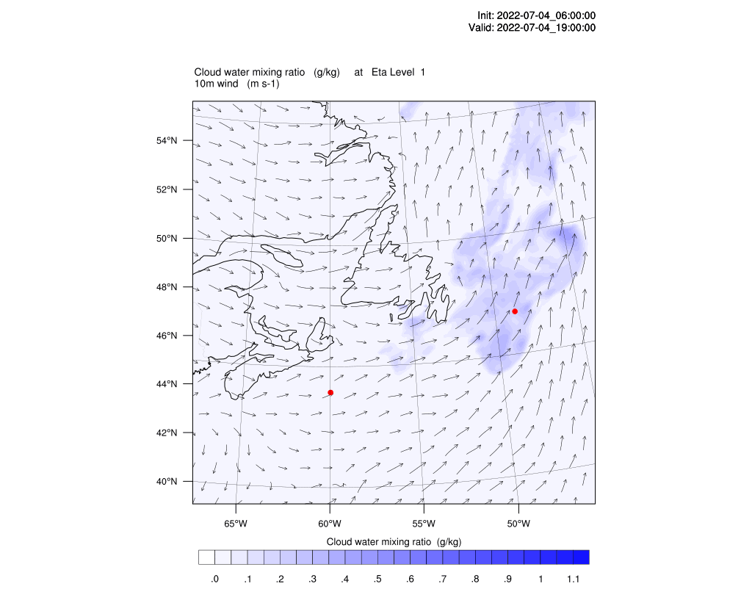
4m cloud water & 10m wind
Droplet number = 10^8/m^3

Slide 4
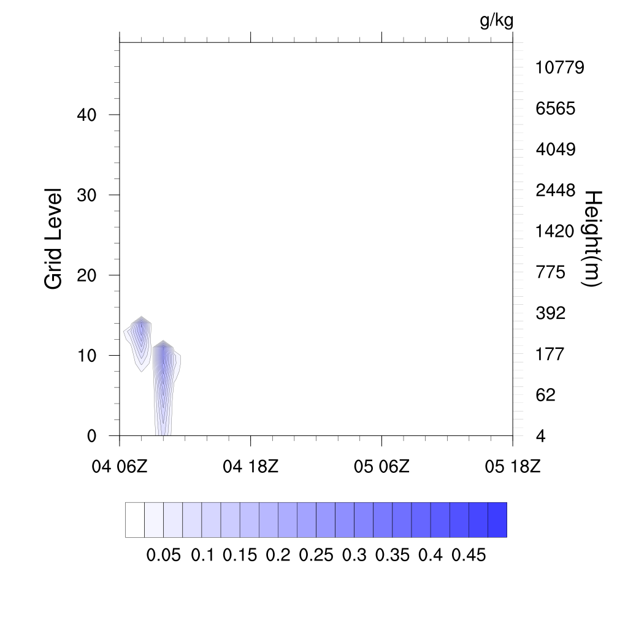
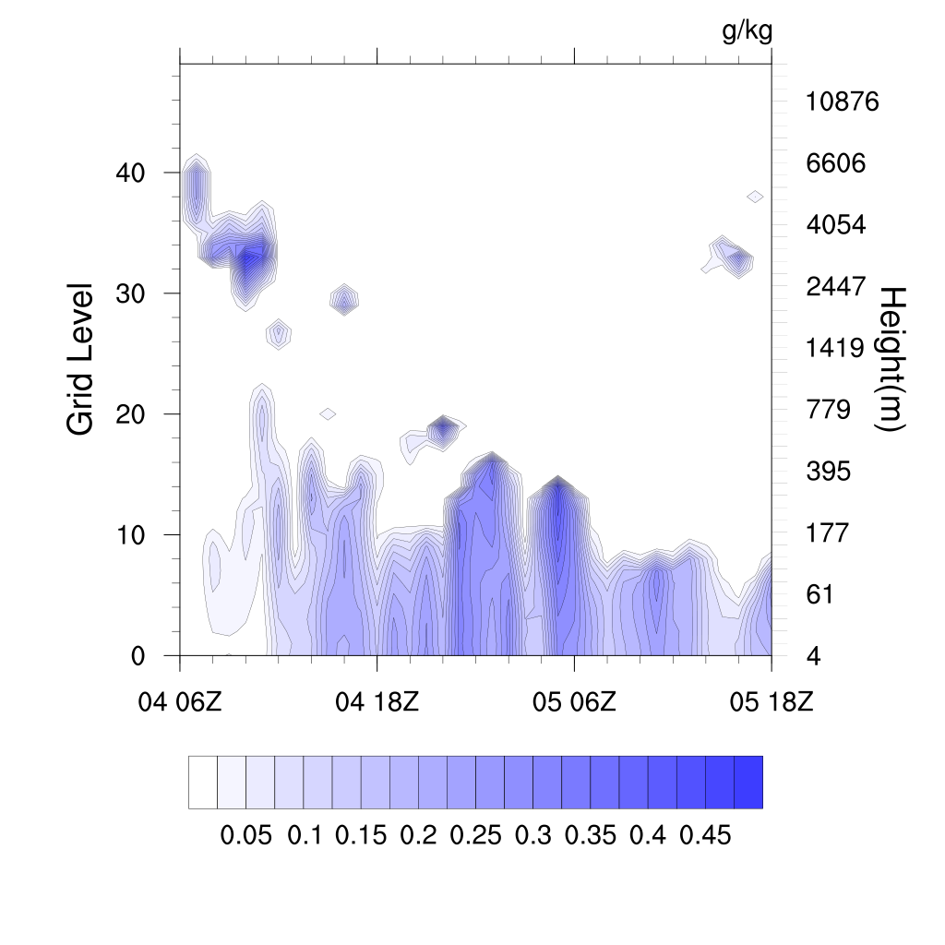
Sable Island
Hibernia

